Slide 1

GENERAL NETWORK DESIGN
Nguyễn Huỳnh Huy
BM Mạng Máy Tính và Tryền Thông
Khoa Công Nghệ Thông Tin
Trường Đại học Nha Trang
Email:huynh@ntu.edu.vn

Slide 2

CHAPTER III DESIGN (1)

Slide 3
CHƯƠNG III : DESIGN (1)
Nội dung
Phương hướng tiếp cận
Mô hình cấu trúc

Slide 4
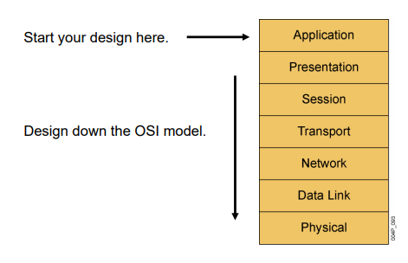
CHƯƠNG III : DESIGN (1)
1. Phương hướng tiếp cận
Top-down Approach
Bottom-up Approach

Slide 5
CHƯƠNG III : DESIGN (1)
1. Phương hướng tiếp cận
Top-down Approach
Analysis of application and organization requirements
Design from the top of the OSI reference model
Define requirements for upper layers (Application, Presentation, Session)
Specify infrastructure for lower OSI layers (transport, network, data link, physical)
Gather additional data on the network

Slide 6
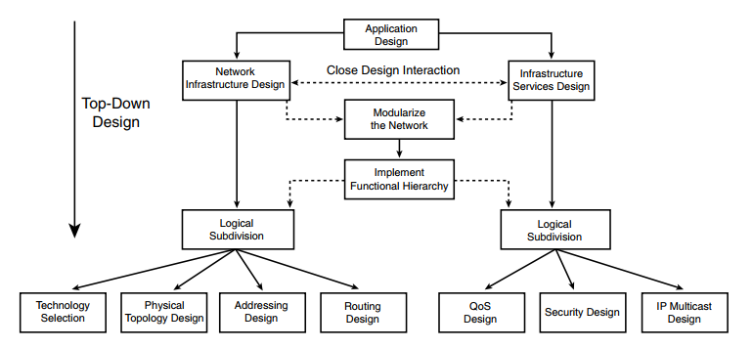
CHƯƠNG III : DESIGN (1)
1. Phương hướng tiếp cận

Slide 7
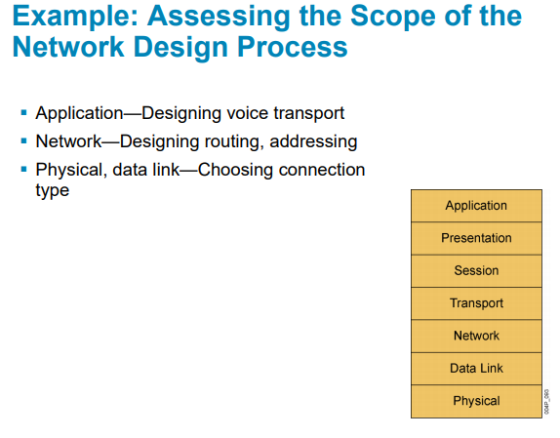
CHƯƠNG III : DESIGN (1)
1. Phương hướng tiếp cận

Slide 8
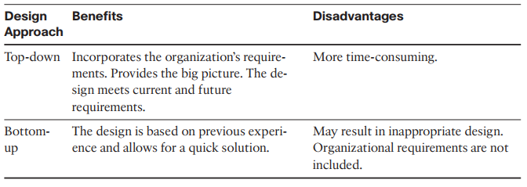
CHƯƠNG III : DESIGN (1)
1. Phương hướng tiếp cận

Slide 9
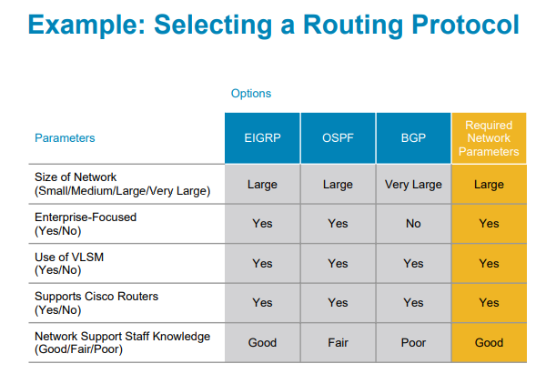
CHƯƠNG III : DESIGN (1)
1. Phương hướng tiếp cận

Slide 10
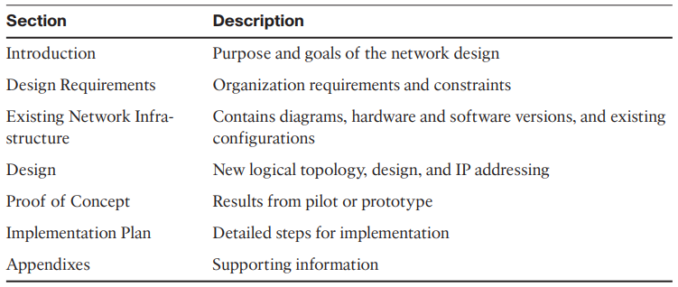
CHƯƠNG III : DESIGN (1)
1. Phương hướng tiếp cận
Design Document

Slide 11
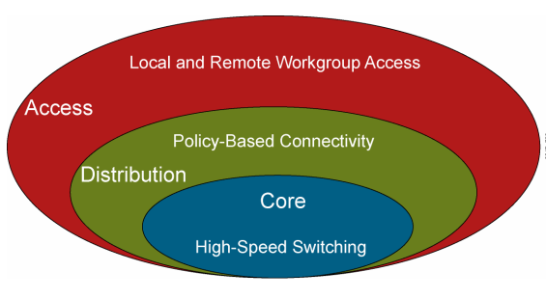
CHƯƠNG III : DESIGN (1)
2. Mô hình cấu trúc
Hierarchy

Slide 12
CHƯƠNG III : DESIGN (1)
2. Mô hình cấu trúc
Hierarchy - Advantages
Reduces workload on network devices
Constrains broadcast domains
Enhances simplicity and understanding
Facilitates changes
Facilitates scaling to a larger size

Slide 13
CHƯƠNG III : DESIGN (1)
2. Mô hình cấu trúc
Hierarchy
A core layer of high-end routers and switches that are optimized for availability and speed
A distribution layer of routers and switches that implement policies and segment traffic
An access layer that connects users via hubs, switches, and other devices

Slide 14
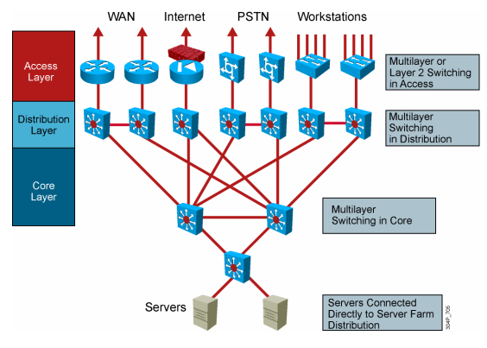
CHƯƠNG III : DESIGN (1)
2. Mô hình cấu trúc
Hierarchy Network Design

Slide 15
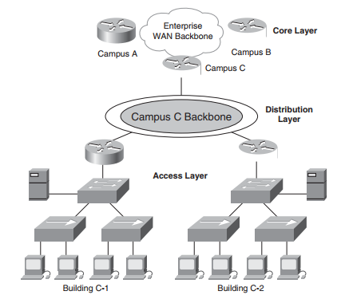
CHƯƠNG III : DESIGN (1)
2. Mô hình cấu trúc
Hierarchy Network Design

Slide 16
CHƯƠNG III : DESIGN (1)
2. Mô hình cấu trúc
Hierarchy Network Design – Access Layer
Concentration point at which clients access the network
Layer 2 switching in the access layer: Defines a single broadcast domain
Multilayer switching in the campus access layer: Optimally satisfies the needs of a particular user through routing, filtering, authentication, security, or quality of service
Multilayer switching in the WAN access layer: Helps control WAN costs using dial-on-demand routing (DDR) and static routing

Slide 17
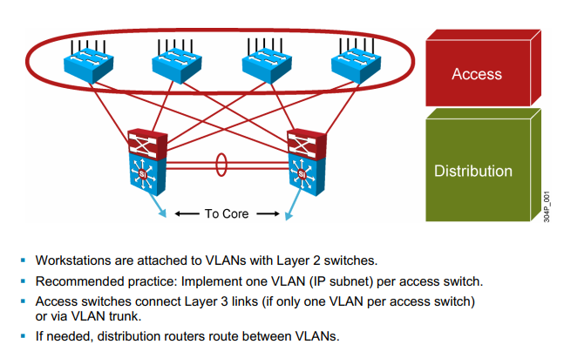
CHƯƠNG III : DESIGN (1)
2. Mô hình cấu trúc
Hierarchy Network Design – Access Layer

Slide 18
CHƯƠNG III : DESIGN (1)
2. Mô hình cấu trúc
Hierarchy Network Design – distribution Layer
Provides multilayer switching between access and core layers:
Provides media transitions
Aggregates bandwidth by concentrating multiple low-speed access links into a high-speed core link
Determines department or workgroup access
Provides redundant connections for access devices

Slide 19
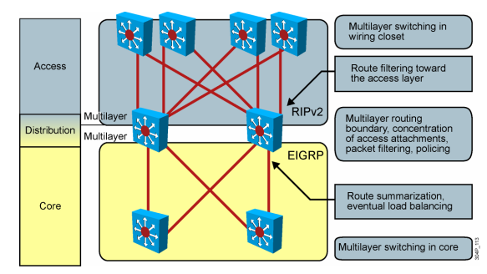
CHƯƠNG III : DESIGN (1)
2. Mô hình cấu trúc
Hierarchy Network Design – distribution Layer

Slide 20
CHƯƠNG III : DESIGN (1)
2. Mô hình cấu trúc
Hierarchy Network Design – distribution Layer
Implements policy-based decisions:
Filtering by source or destination address
Filtering on input or output ports
Hiding internal network numbers by route filtering
Static routing
Security
Quality of service mechanisms

Slide 21
CHƯƠNG III : DESIGN (1)
2. Mô hình cấu trúc
Hierarchy Network Design – Core Layer
The function of the core layer is to provide fast and efficent data transport that:
Forms a high-speed backbone with fast transport services
Provides redundancy and fault tolerance
Offers good manageabilit

Slide 22
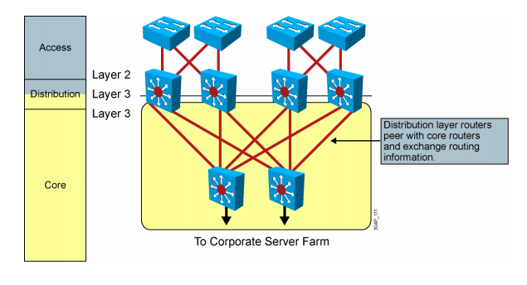
CHƯƠNG III : DESIGN (1)
2. Mô hình cấu trúc
Hierarchy Network Design – Core Layer

Slide 23
CHƯƠNG III : DESIGN (1)
Flat Versus Hierarchy
A flat network topology is adequate for small networks. With a flat network design, there is no hierarchy. Each network device has essentially the same job, and the network is not divided into layers or modules. A flat network topology is easy to design and implement, and it is easy to maintain, as long as the network stays small.
Headquarters in Medford
Grants Pass Branch Office
Klamath Falls Branch Office
Ashland Branch Office
Flat Loop Topology

Slide 24
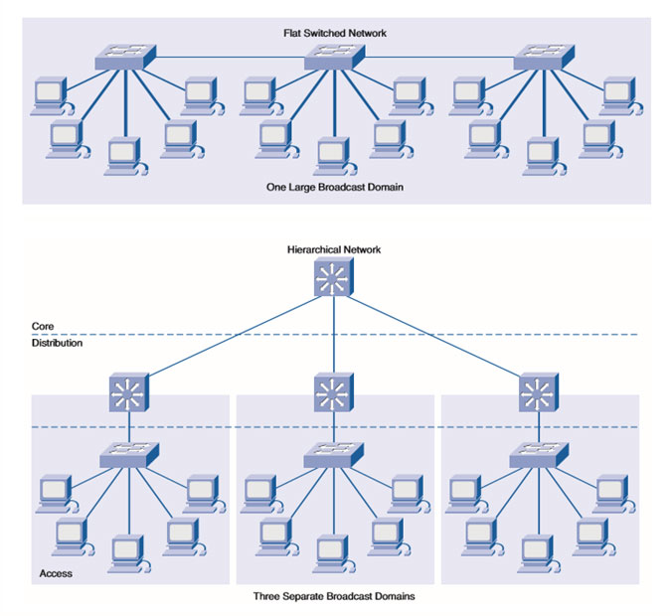
CHƯƠNG III : DESIGN (1)
Flat Versus Hierarchy

Slide 25
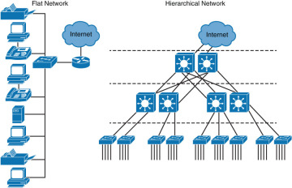
CHƯƠNG III : DESIGN (1)
Flat Versus Hierarchy

Slide 26
CHƯƠNG III : DESIGN (1)
Mesh Designs
Network designers often recommend a mesh topology to meet availability requirements. In a full-mesh topology, every router or switch connects to every other router or switch. A full-mesh network provides complete redundancy and offers good performance
Partial-Mesh Topology

Slide 27
CHƯƠNG III : DESIGN (1)
Mesh Designs
Partial-Mesh Topology
Full-Mesh Topology

Slide 28
A Partial-Mesh Hierarchical Design
Headquarters (Core Layer)
Regional Offices (Distribution Layer)
Branch Offices (Access Layer)

Slide 29
CHƯƠNG III : DESIGN (1)
2. Mô hình cấu trúc
Redundancy – Dự phòng
Redundant network designs enable you to meet requirements for network availability by duplicating elements in a network.
Redundancy attempts to eliminate any single point of failure on the network. To enable business survivability after a disaster and offer performance benefits from load sharing, some organizations have completely redundant data centers.

Slide 30
CHƯƠNG III : DESIGN (1)
2. Mô hình cấu trúc
Redundancy – Dự phòng
Before you select redundant design solutions, you should first analyze the business and technical goals of your customer, as discussed in Part I, “Identifying Your Customer’s Needs and Goals.” Make sure you can identify critical applications, systems, internetworking devices, and links. Analyze your customer’s tolerance for risk and the consequences of not implementing redundancy.
Make sure to discuss with your customer the tradeoffs of redundancy versus low cost, and simplicity versus complexity. Redundancy adds complexity to the network topology and to network addressing and routing.

Slide 31
CHƯƠNG III : DESIGN (1)
2. Mô hình cấu trúc
Redundancy – Dự phòng
Backup Paths
How much capacity the backup path supports
How quickly the network will begin to use the backup path
Load Sharing (Load balancing)

Slide 32

CHƯƠNG III : DESIGN (1)
2. Mô hình cấu trúc
Redundancy

Slide 33
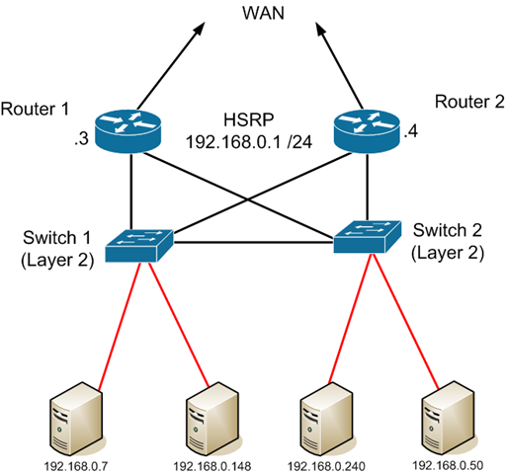
CHƯƠNG III : DESIGN (1)
2. Mô hình cấu trúc
Redundancy

Slide 34
Nguyễn Huỳnh Huy
Bộ môn Mạng Máy Tính và Tryền Thông
Khoa Công Nghệ Thông Tin
Trường Đại học Nha Trang
Email:huynh@ntu.edu.vn

